Slide 1

A
Minor Project synopsis
on
Recognition of Assamese Handwritten Numerals
Under the Guidence of
Mr. Rubul Kr. Bania, Assistant Professor , Department of Computer Application North-Eastern Hill University Tura Campus Meghalaya
DONE BY:
Welbert Marwet Sajida Begum
RollNo: CAM1511 RollNo: CAM1503
Notes:
<number>

Slide 2
OVERVIEW
INTRODUCTION
TITLE
RELATED STUDY
MOTIVATION
OBJECTIVES
OVERVIEW OF THE SYSTEM
METHODOLOGY
TOOLS/PLATFORM
REFRENCES

Slide 3
INTRODUCTION
Character recognition is an important area in the field of image processing and pattern recognition.
Although digits are subset of any languages, character sets they are very important to many applications. Many applications require only digit identification.
The handwritten character recognition system(HCR) is of two types:
(i) off-line : The input is taken in the form of digital image by scanning the handwritten text.
(ii) on-line: The input is taken in pressure sensitive surfaces (digital tablet PCs) from the writer dynamically.

Slide 4
Title:
Recognition of Assamese Handwritten Numerals
Definition:
Character recognition is an important area in the field of image processing and pattern recognition which is capable of recognizing human or machine written characters. In this work we are trying to recognize 10 digits of Assamese numerals.

Slide 5
These OCR are generic type capable of recognizing characters with different fonts and sizes even intermixing text and graphics.
Table 1: Assamese numerals
Assamese ১ ২ ৩ ৪ ৫ ৬ ৭ ৮ ৯ ০
English 1 2 3 4 5 6 7 8 9 0

Slide 6
Related Study:
Recognition of handwritten numerals is the process of identifying individual digits. In compare to other languages like English, Bengali, Hindi , very little work has done on the Assamese handwritten numerals.
Kalyanbrat Medhi[1] , the aim of this paper is to design a recognizer to recognize Assamese digits using feed forward neural network. The recognizer crops the individual digits of the image using bounding box method and extracts the feature.

Slide 7
MOTIVATION
Literature review reveals that studies on Telugu , Bangla are carried out by several researchers .
But less efforts has been put to develop character recognition tool for the North-Eastern languages, particularly the Assamese language.
The lack of effective research work in Assamese language motivated us to develop a handwritten digit recognizer.

Slide 8
Objectives:
To prepare a dataset for Ten digits of Assamese numerals.
To preprocessed the input digital image to get rid of noise or some other processes for further task.
Implementation of feature extraction process to obtain the set of feature sets of handwritten Assamese digits.
Recognize the digits.

Slide 9
overview of the system
Input Color Image RGB
to GreyScale
Preprocessing
Noise Removal
Segmentation (Filtering)
(Character)
Binarization
Feature Extraction
Classification

Slide 10
METHODOLOGY
Pre-processing: The pre-processing is a set of operation performed on the input document.
Segmentation: Segmentation subdivides an image into its constituent regions or objects.
Feature extraction: This process extracts the geometric features of a numeric which comprises of the basic line types that forms the character skeleton.
Classification: During classification the system recognizes a character based on the training database.

Slide 11
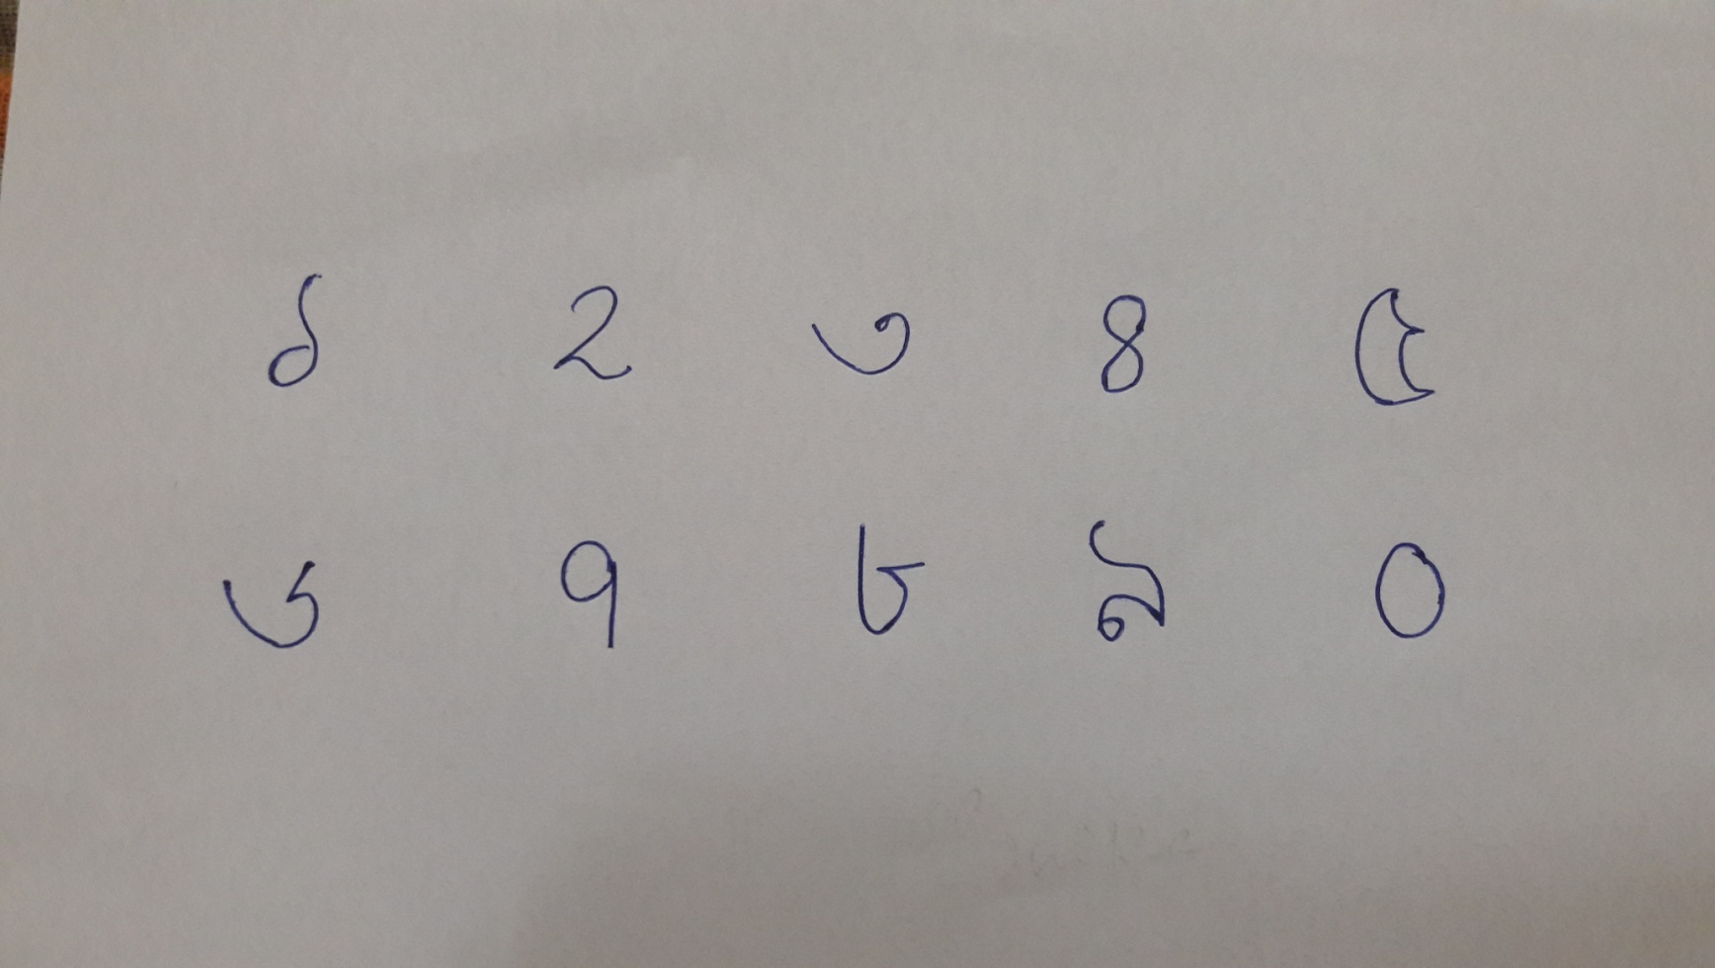
Sample of handwritten Assamese digits

Slide 12
Tools/Platform:
Software: OS: windows-7/8/10
Programming Language: MATLAB.
Processor: Intel Core i3, RAM: 4GB.

Slide 13
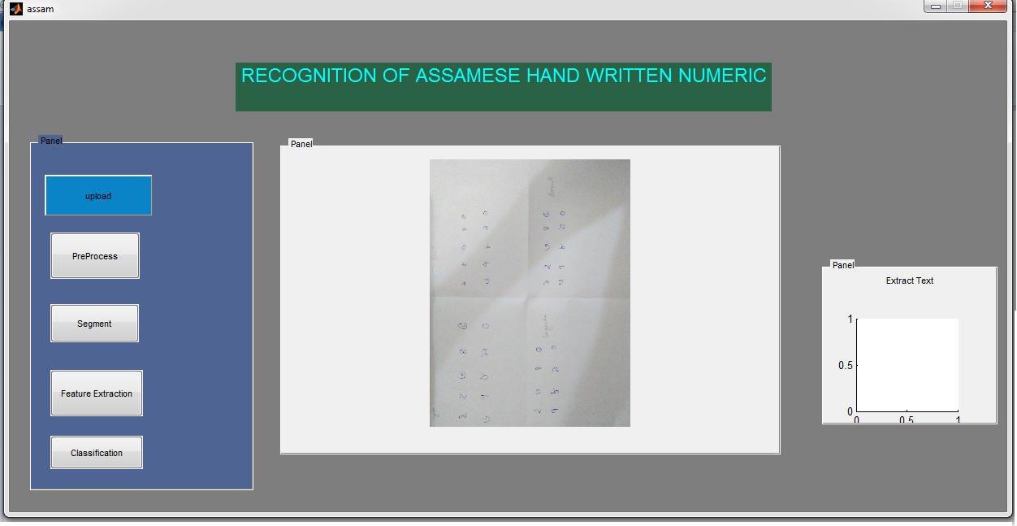
Screenshot of output

Slide 14
References:
Kalyanbrat Medhi, Dr. Sanjib Kr. Kalita, “Assamese Digit Recognition with Feed Forward Neural Network” International Journal of Computer Applications, PP-34-39 , Volume 109 – No. 1, January 2015.
Sagarika Borah, “Segmentation of Assamese Handwritten Characters based on Projection Profiles” International Journal of Computer Applications , PP-12-17, Volume 130 – No.17, November2015.
K. Bhattacharyya, K. K. Sarma, ANN-based Innovative Segmentation Method for Handwritten text in Assamese, IJCSI International Journal of Computer Science, Vol. 5, PP:9-16, 2009.
J. J. Hull, document image skew detection: survey and annotated bibliography, Document Analysis Systems II- World Scientific, PP: 40-64, 1998.
U. Pal, B.B. Chaudhuri, Indian script character recognition: a survey, Pattern Recognition 37, PP:1887 – 1899, 2004.

Slide 15
END SLIDE
THANK YOU

